Slide 1
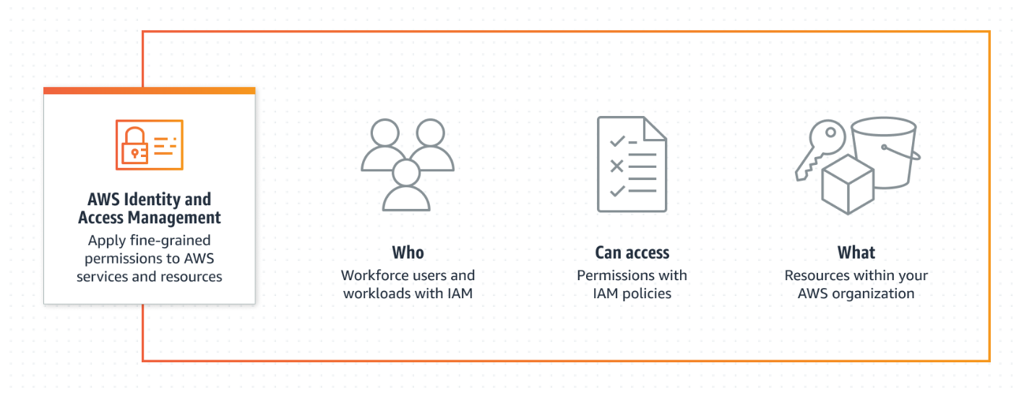
AWS Identity and Access Management (IAM)
AWS Identity and Access Management (IAM) is a web service that enables Amazon Web Services (AWS) customers to manage users and user permissions in AWS. With IAM, you can centrally manage users, security credentials such as access keys, and permissions that control which AWS resources users can access.

Slide 2
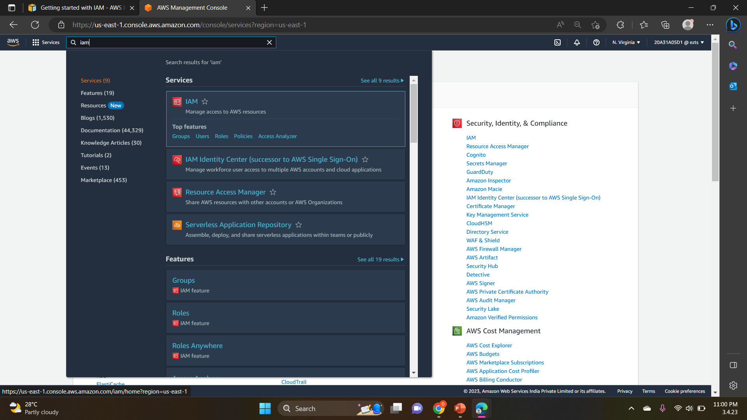
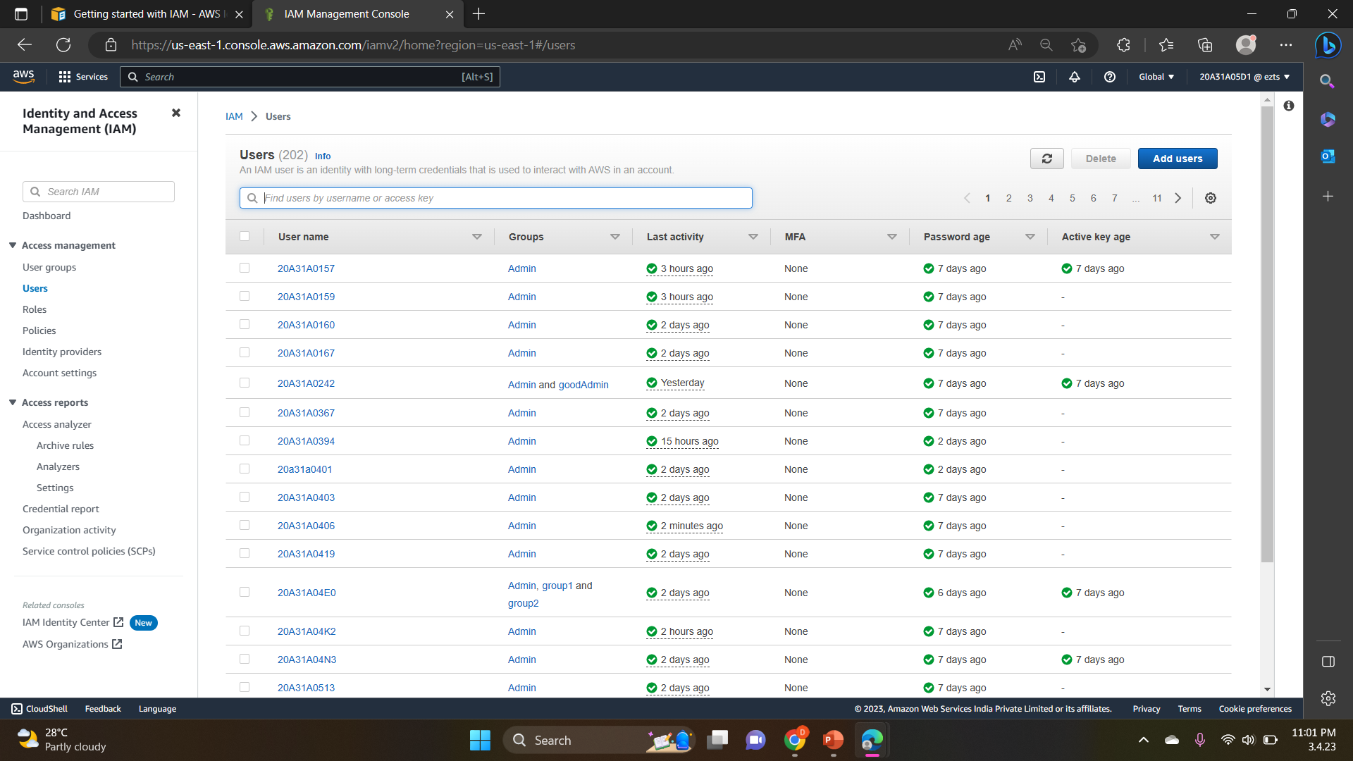
Steps to create IAM User and User Groups
On the Console Home page, select the IAM service.
2.In the navigation pane, select Users and then select Add users.

Slide 3
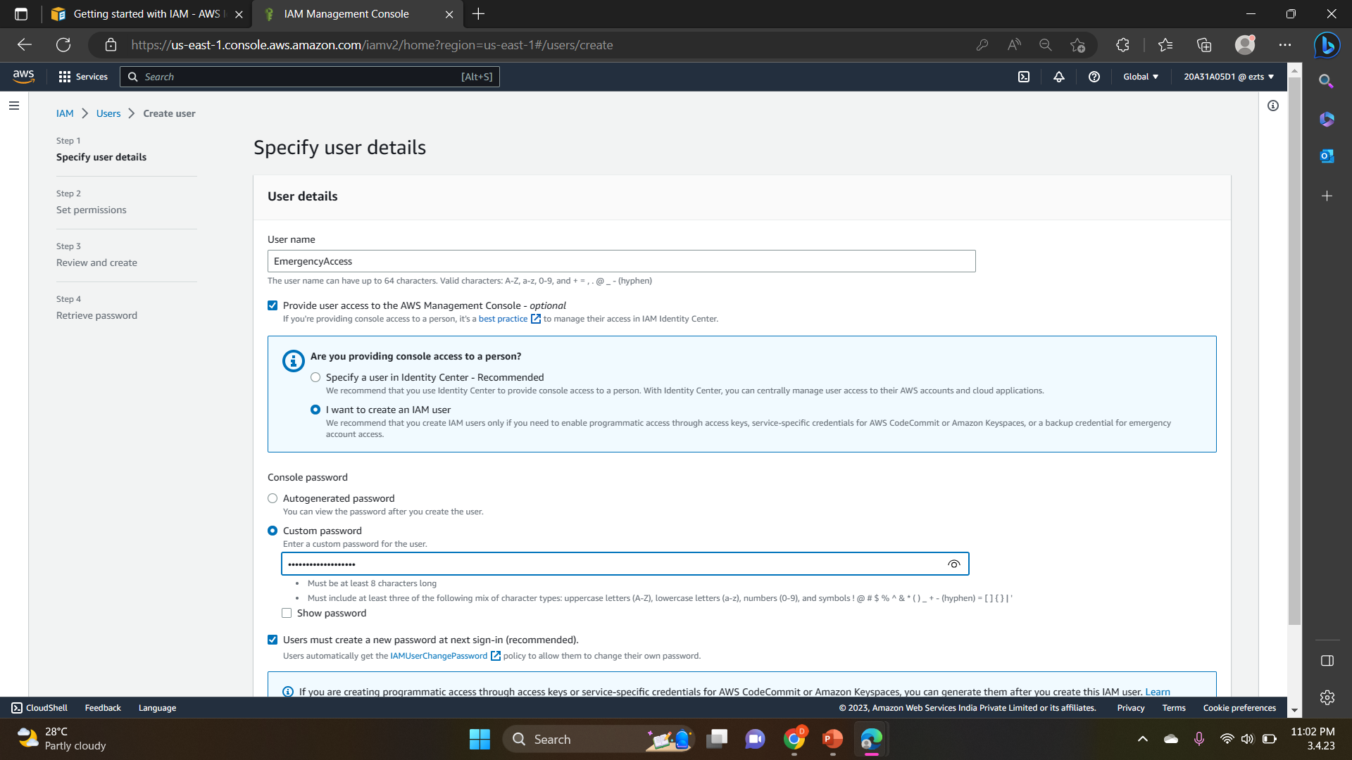
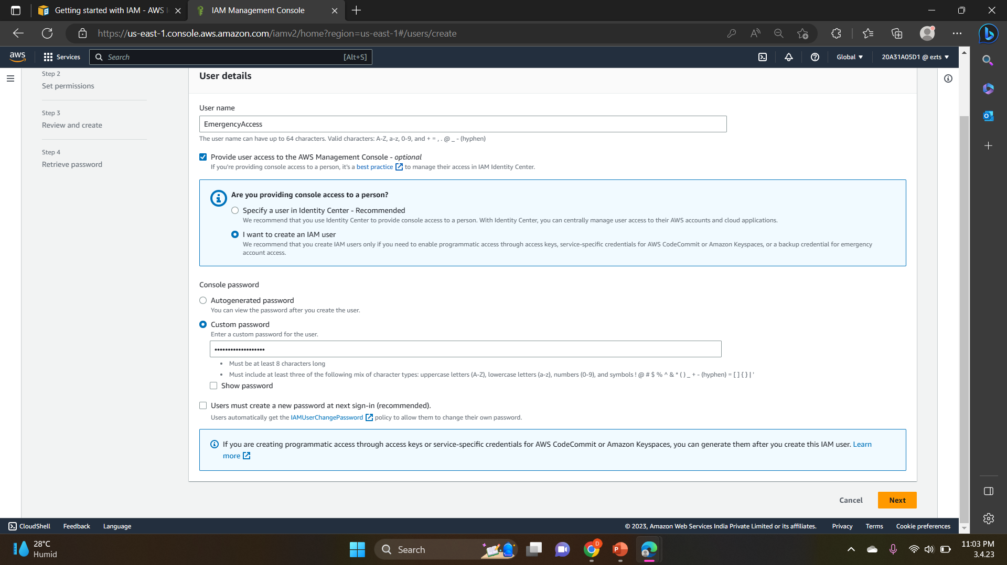
3.For Username, enter EmergencyAccess and ,Select the check box next to Provide user access to the AWS Management Console– optional and then choose I want to create an IAM user.
4.Under Console password, select Custom Password and create your own password.
5. Clear the check box next to User must create a new password at next sign-in (recommended). Then click on Next.

Slide 4
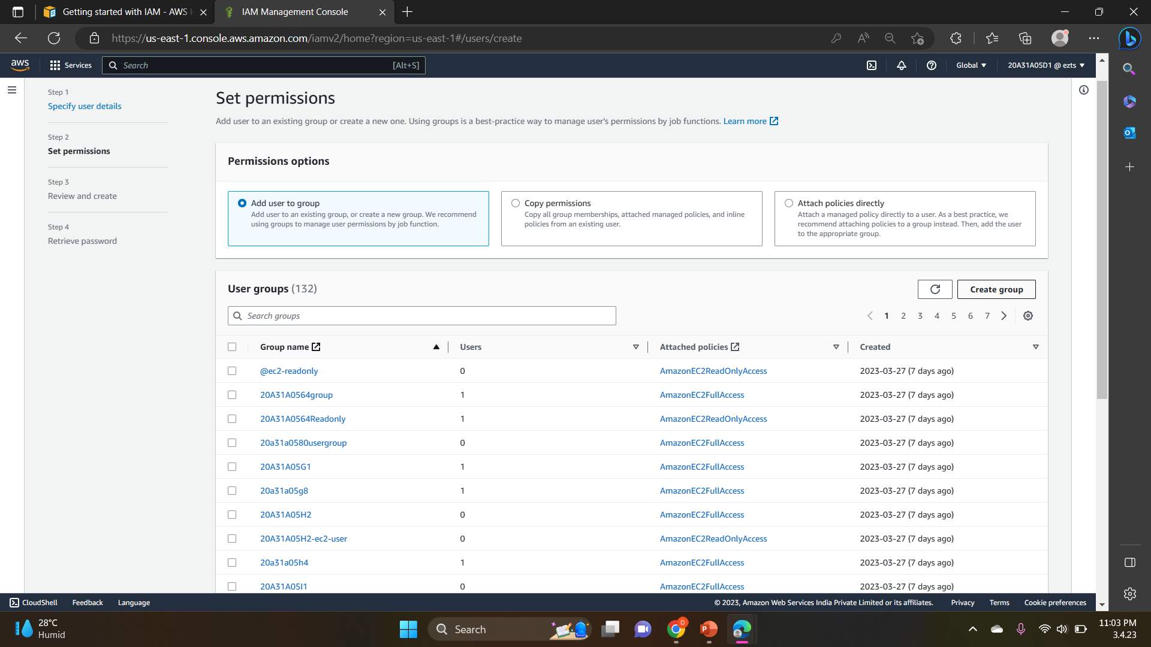
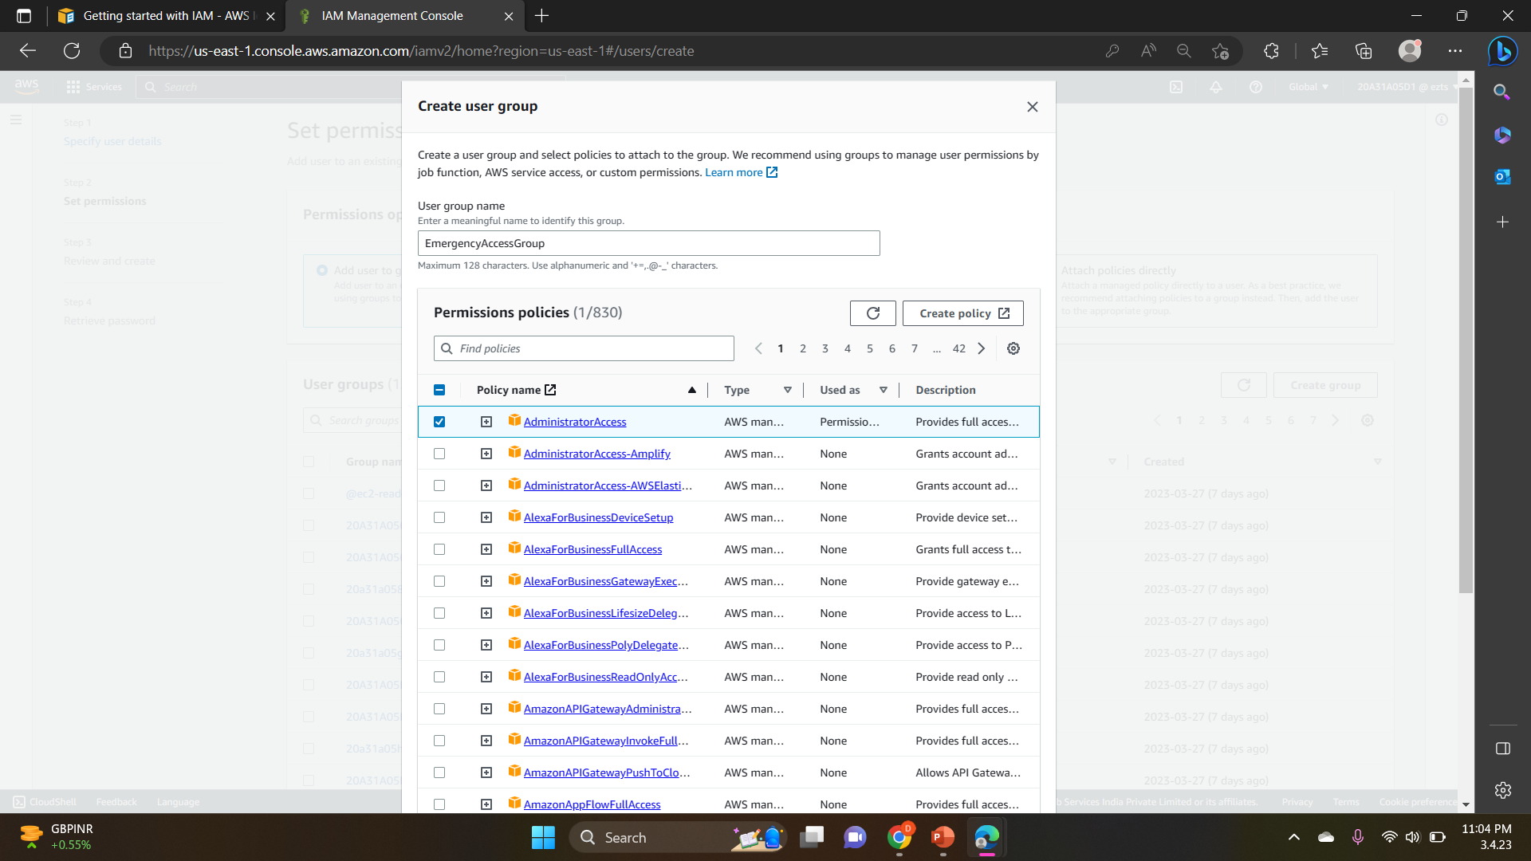
6. On the Set permissions page, under Permissions options, select Add user to group. Then, under User groups, select Create group.
7. On the Create user group page, in User group name, enter EmergencyAccessGroup. Then, under Permissions policies, select AdministratorAccess.

Slide 5
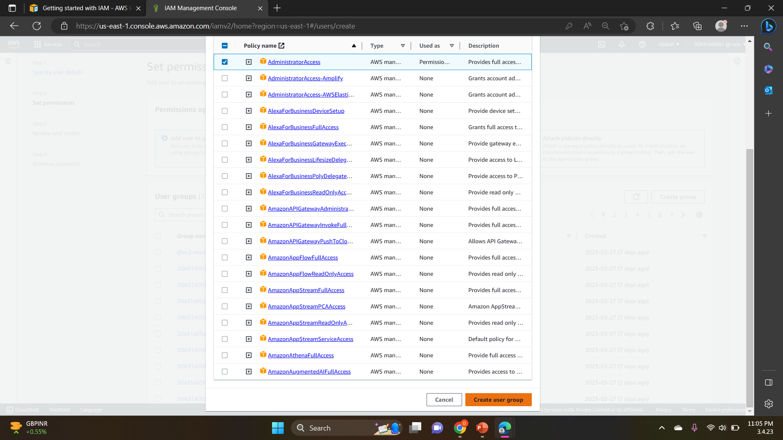
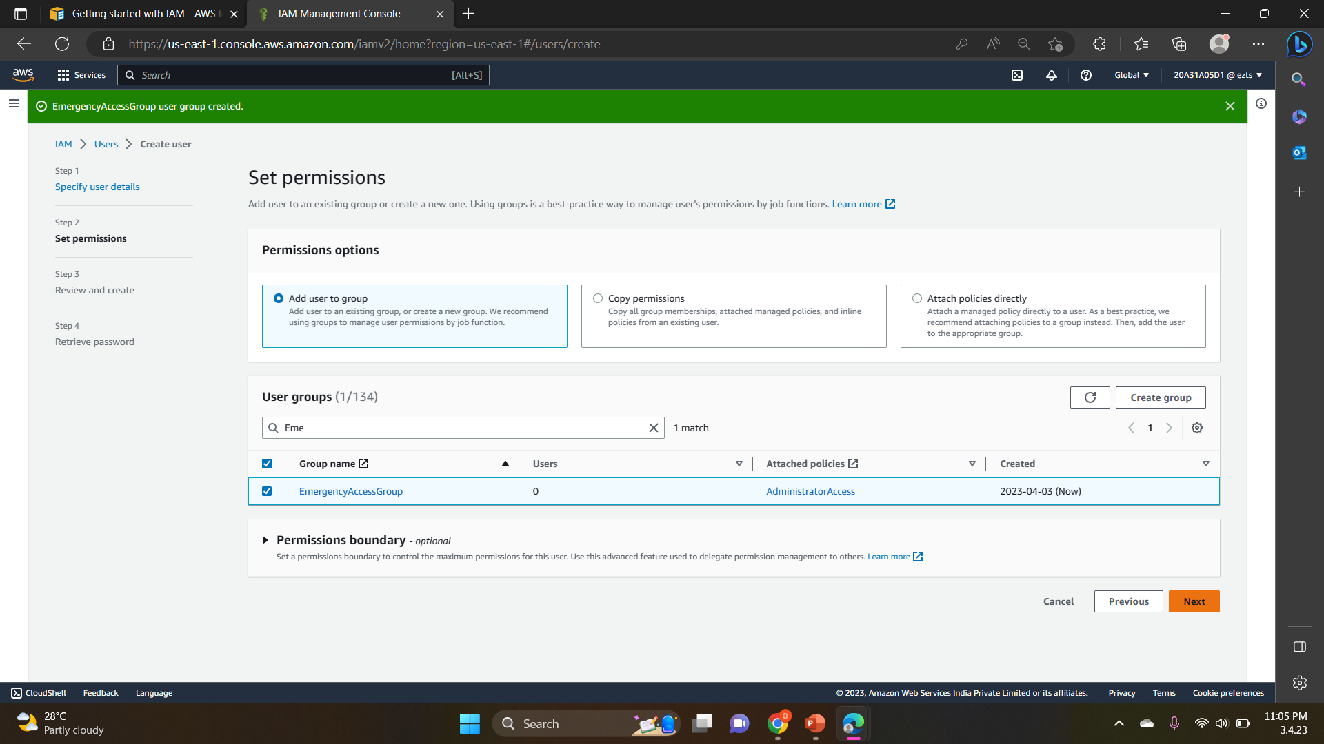
8. Select Create user group to return to the Set permissions page.
9. Select Next to proceed to the Review and create page.

Slide 6
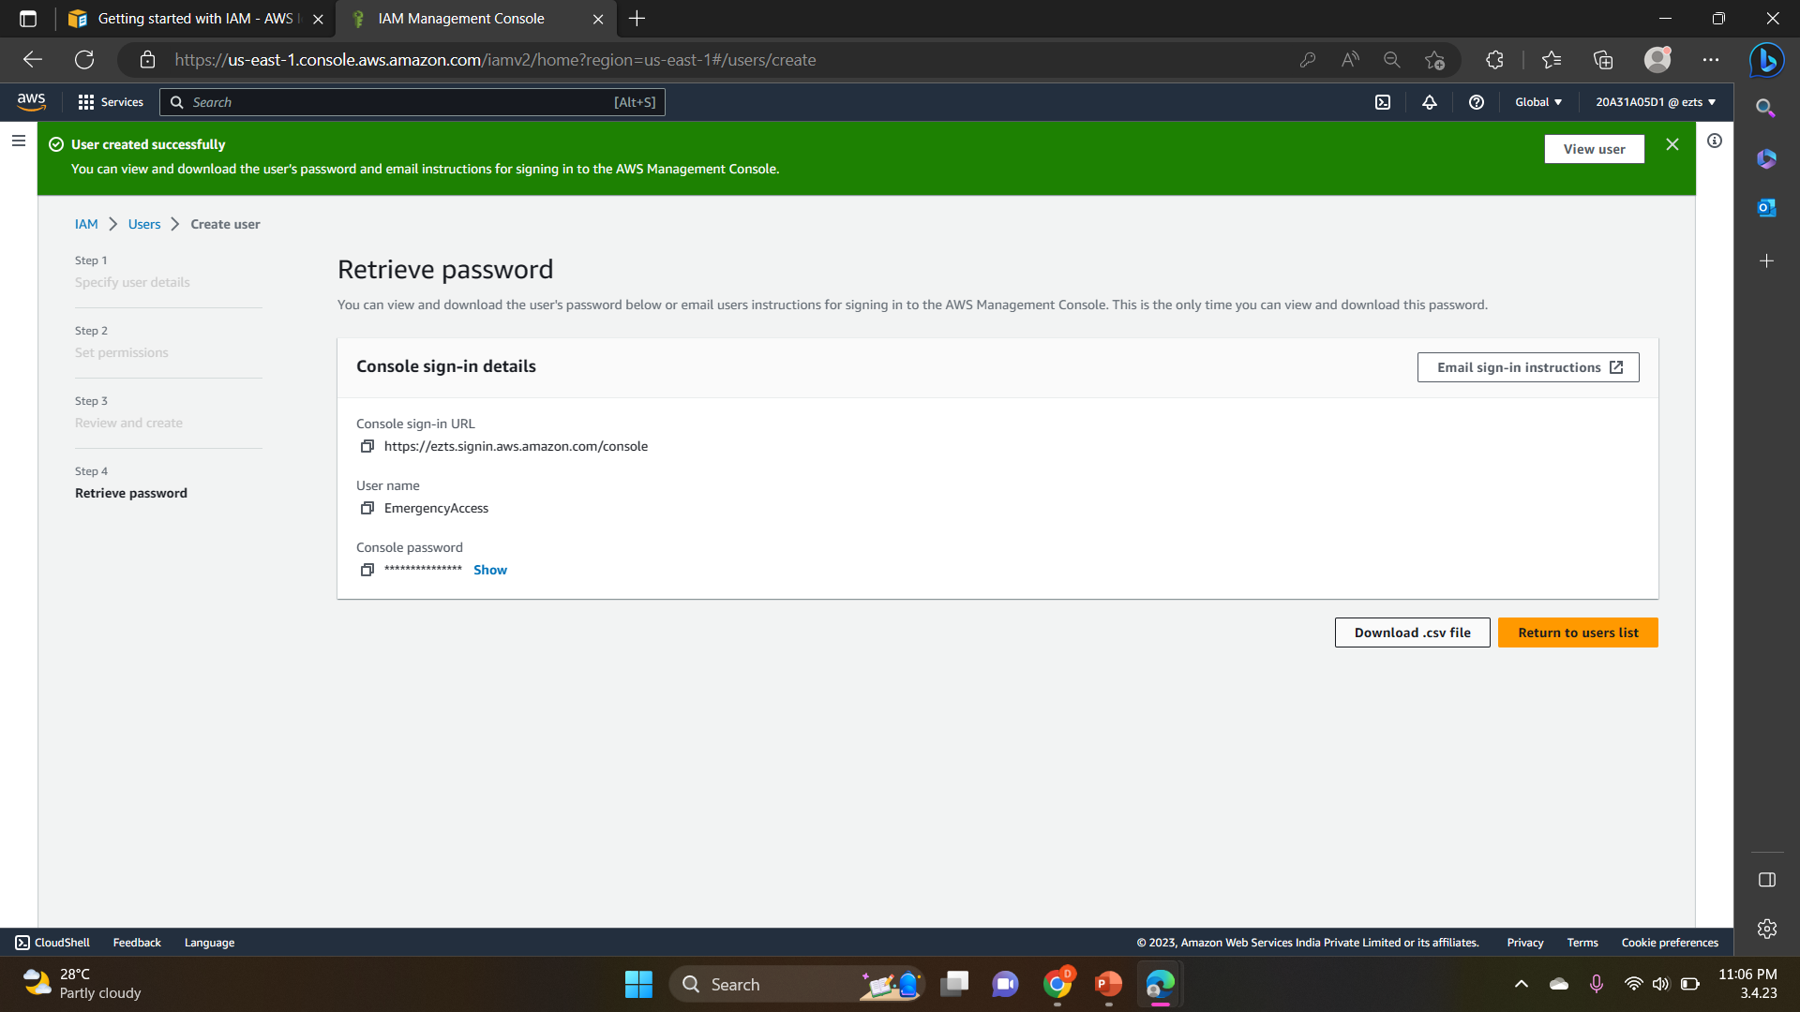
10.On the Review and create page, review the list of user group memberships to be added to the new user. When you are ready to proceed, select Create user.
11. On the Retrieve password page, select Download .csv file to save a .csv file with the user credential information (Connection URL, user name, and password).
12. Save this file to use if you need to sign-in to IAM and do not have access to your federated identity provider.

Slide 7
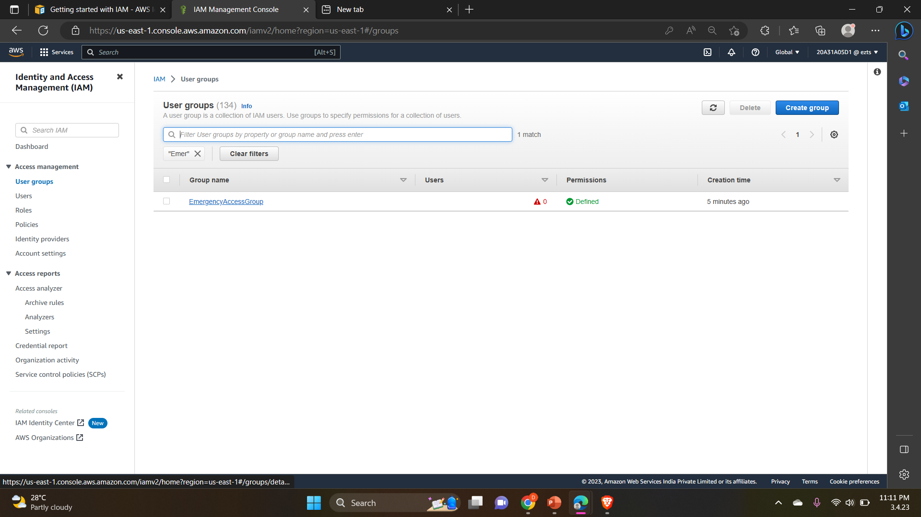
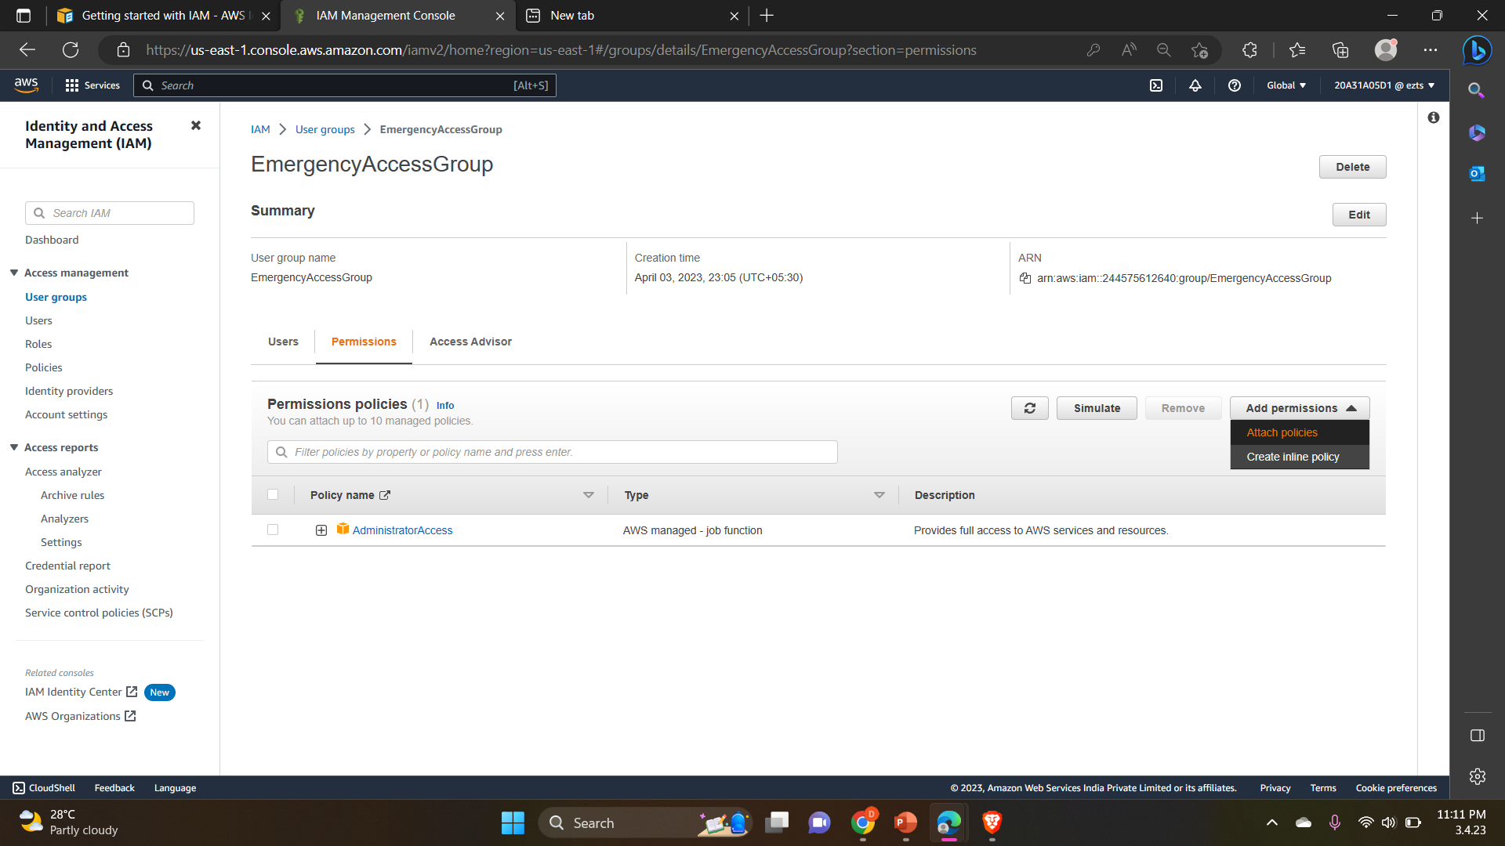
13. If you want to add permissions to the user group, then go to User groups and click on the respective User group.
14. Go to Permissions → All permissions→ Attach policies

Slide 8
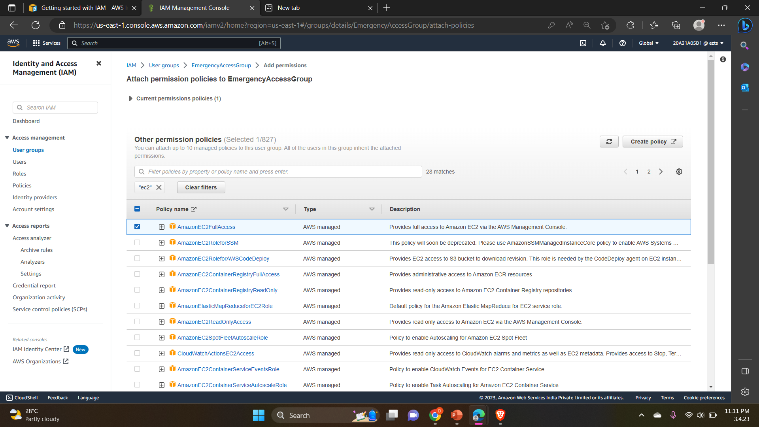
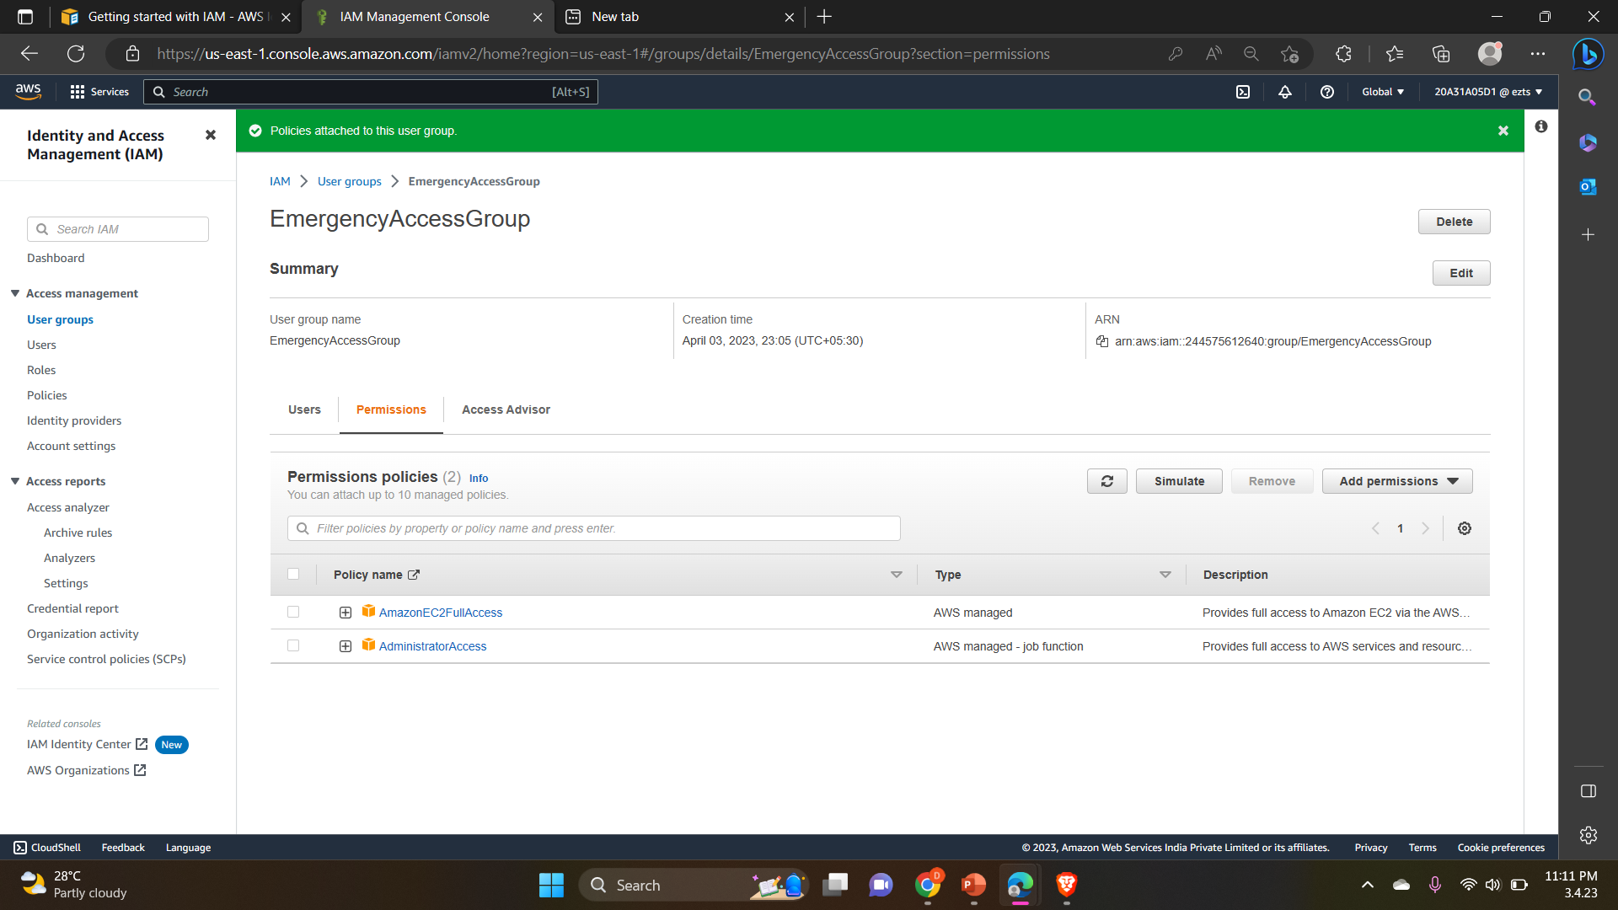
15. Add the permission policy and the policy is attached to the User group.

